Slide 1
COMP 2139
Lab 1 – Import/Open Exisitng Project

Slide 2
Open an existing project
Instructions
If the project is compressed, unzip the project folder on your disk
From within Visual Studio, perform File → Open → Project/Solution
Navigate to the uncompressed project folder
Inside the project folder, select and opem the .sln file
Visual Studio will open the project, including all necessary related project files

Slide 3
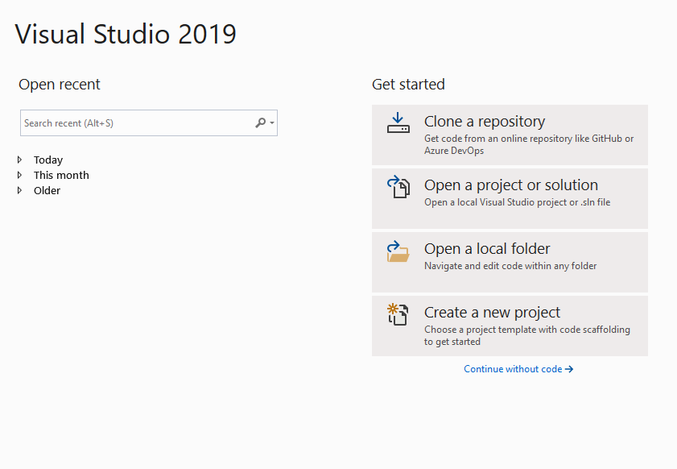
Open an Existing Project
Open Visual Studio

Slide 4
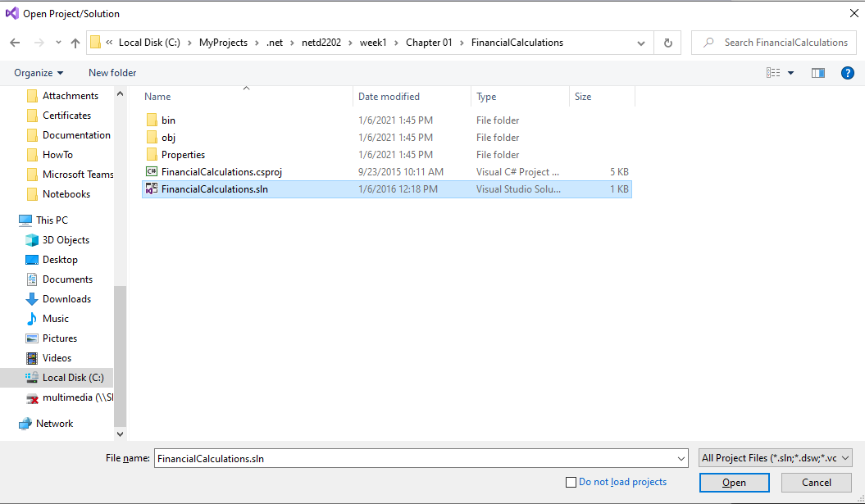
Open existing Project
Navigate to the project folder, locate and open the .sln file associated with the project

Slide 5
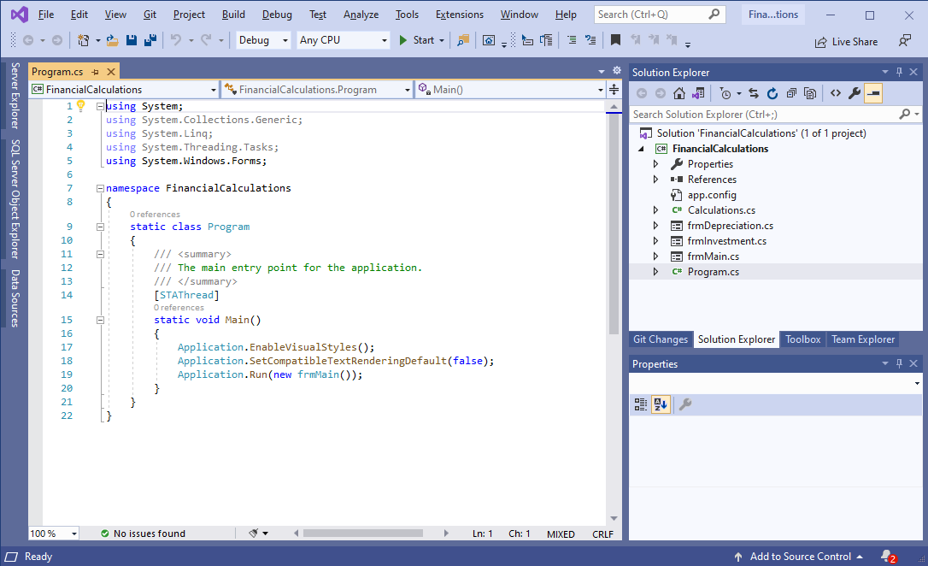
Open existing Project
The Visual Studio IDE will open the project in the existing workspace

Slide 6
Questions?

